Slide 1

Exciting Learning Ahead at Hollingwood
Half Term Four

Slide 2




Nursery - Saplings
Communication and Language
Understand and use who,what,where in simple questions.
Use longer sentences.
Develop understanding of simple concepts ( e.g fast/slow, good/bad )
Literacy
Distinguish between the different marks they make
Enjoy rhythmic and musical activity with percussion instruments, actions, rhymes and songs. Joining in with words of familiar songs and rhymes.
Mathematics
Begin to compare and recognise changes in numbers of things, using words like more, lots or ‘same’
Topic Texts
Phonics
Rhyme Time
Sound Focus - u r h b f
Expressive Arts and Design
Begin to make believe by pretending using sounds, movements, words, objects.
Show an interest in the way sound makers and instruments sound and experiments with ways of playing them, e.g. loud/quiet, fast/slow
Physical Development
Develop body strength through coordination, balance and agility
Develop the foundations of a handwriting style
Understanding the World
Learn that they have similarities and differences that connect them to, and distinguish them from, others. Celebrations such as Mother’s Day, Easter, Ramadan and Eid
PSED
Increasingly independently put on and take off simple clothing items such as hats, unzipped jackets, wellington boots

Slide 3




Reception - Apple and Pear
Communication and Language
Use language during play to imitate others
Learn to listen to others with increasing attention and respond in appropriate ways, comment, question or action.
Follow multi-part instructions by listening to others.
Literacy
Give meaning to marks
Write full name
Begin to write cvc words, phrases and simple sentences in meaningful contexts.
Use vocabulary from stories
Mathematics
Length, height and time
Exploring numbers 9 and 10
Exploring 3D shapes
Topic Texts
Phonics
words with double letters, longer words, words with two or more digraphs, words ending in –ing, compound words, words with s /z/ in the middle, words with –s /s/ /z/ end
Expressive Arts and Design
Design Mother’s Day cards
Using the equipment to create a model of a rockets or an alien.
Music:
Learn about different styles of music while also finding the rhythm and pulse in songs.
Physical Development
Develop body strength through coordination, balance and agility
Develop the foundations of a handwriting style
Understanding the World
Looking at the features of planets and space. Searching for signs of spring by going on a Spring Walk. Celebrations such as Mother’s Day, Easter, Ramadan and Eid
PSED
My Happy Mind - The Relate module. We will talk about our friends and how we listen and respond to them.

Slide 4
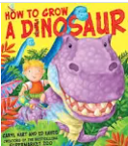

Year 1
Maths
Place Value within 50.
Counting in groups of 10’s to 50.
Numbers 20 - 50 and how they are made.
Reading
Children’s own choice from the library
Art
Shape and colour
Computing
Learning to log on to, and use Purple Mash
Science
Animals
Writing
Instructions, Recount, Book Reviews
DT
Making and evaluating puppets.
RHE
Angry Arthur - Recognising emotions.
Music
Sound Pattern
(Theme - Fairy Tales)
P.E.
Icommunicate - Playtime
Pilates
Class Stories
Stories about Ramadan, Eid and Easter

Slide 5




Year 2
Maths
Length and Height
Mass, Capacity and Temperature
Reading
A range of little wandle reading books
History
Flying Women
Computing
Questioning
Coding
DT
Bendy Bags
Writing
Narrative
Character Description
Tenses, Sentence types
RHE
Feeling safe in different situations
Music
Contrasting dynamics
Theme: Space
P.E.
Gymnastics
Ball skills
Class Stories
A range of Roald Dahl books

Slide 6
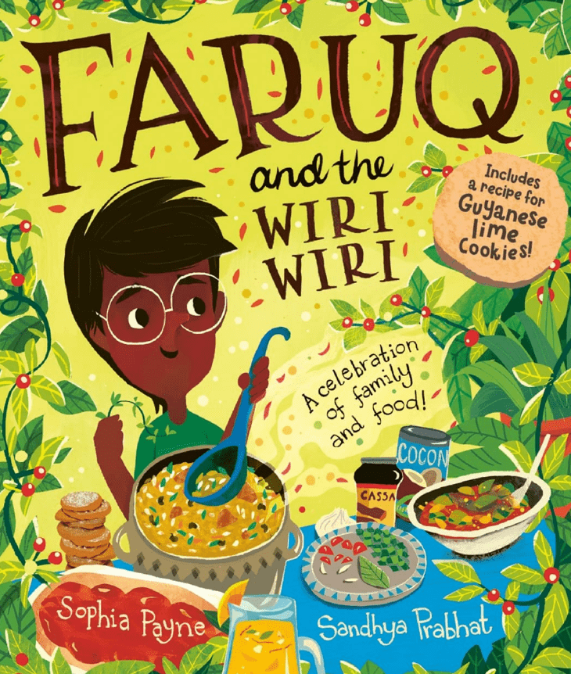


Year 3
Maths
Length and Perimeter
Fractions
Reading
Egyptians
History
Roman Empire
Music
Pentatonic melodies and composition
Science
Light
Writing
So You Think You’ve Got It Bad? Chase Strathie
The Wild Robot by Peter Brown
Geography
Peru
RHE
Explain how food contributes to a balanced lifestyle.
Make choices about the food I eat and I can tell you what affects
the choices I make.Understand how drinks contribute to a
balanced lifestyle.
Class Stories
Butterfly Lion
Spanish
Classroom objects
P.E.
Gymnastics
Hockey

Slide 7




Year 4
Maths
Fractions
Decimals
Reading
Robots
Scotland
RE
Sikhism
Computing
Animation
The internet
Science
States of matter
Writing
Narrative
Book review
Geography
Hawaii
PSHE
The Proudest Blue
Cultural heritage
How my family and friends support me.
Showing respect.
Strategies to deal with bullying.
Impacts of bullying.
Music
Haiku music and performance.
P.E.
Hockey
Gymnastics
Class Stories
Highland Falcon Thief
Spanish
Who I am
Where I live
Numbers and dates.

Slide 8
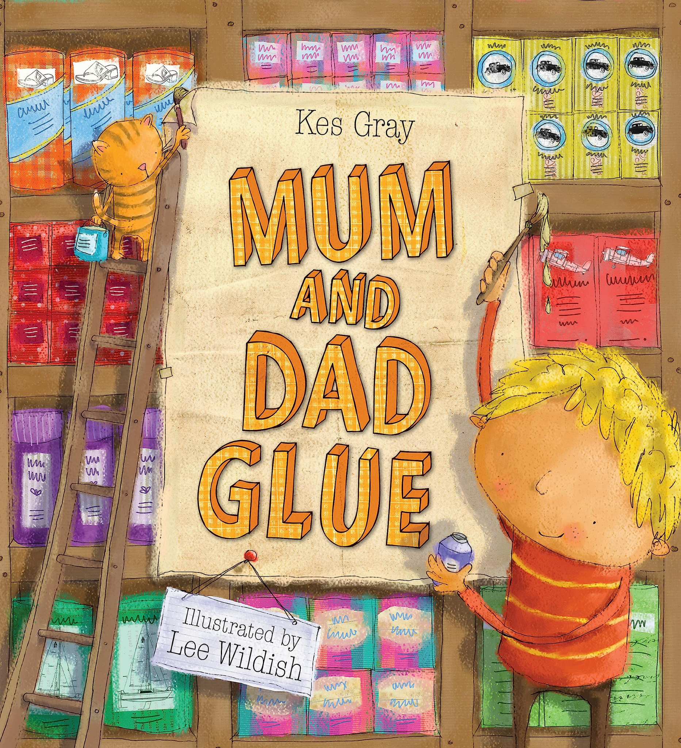

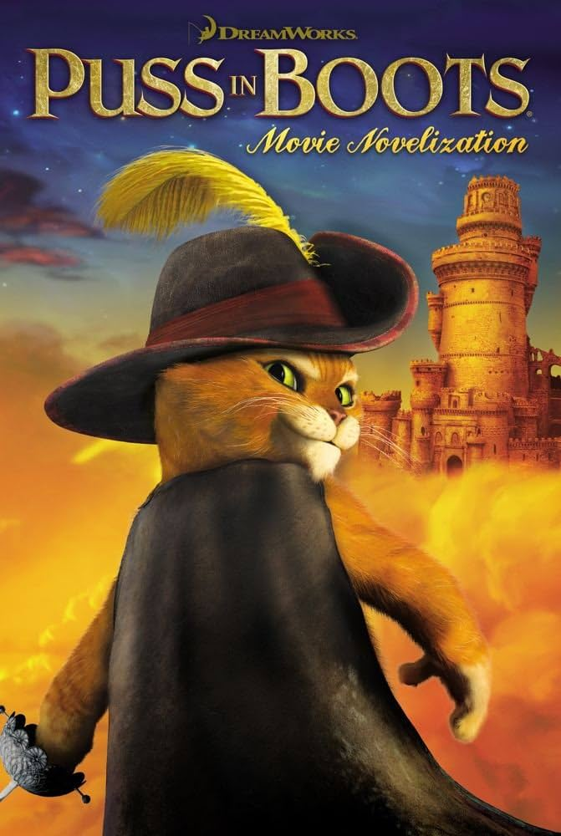

Year 5 - Beech and Chestnut
Maths
Perimeter and Area
Statistics
Shape
Reading
Spooky stories
Space
Climate change
RE
Forgiveness
Art
Egyptian Art
William Morris
Science
Earth and space
RHE
Parental separations
Writing
Diary Writing
Narrative
DT
Sewing - Lavender bags
Music
Blues
P.E.
Badminton
Gymnastics
Class Stories
Space boy
Spooky stories
Spanish
Celebrations

Slide 9




Year 6 - Oak and Sycamore
Maths
Statistics
Geometry
Reasoning
Reading
World Book Day
Various Extracts
RE
Jewish Festivals
Computing
Programming
Art
Video Games
Writing
Diary
Story
History
Early Islamic Civilisation
RHE
Substances
Peer Pressure
Consent
Expressing Needs
Water Safety
Music
Film Music
P.E.
Gymnastics
Badminton
Class Stories
Skellig - David Almond
The Doll Twin - Janine Beacham
Spanish
Spanish Portraits

