Slide 1

Exciting Learning Ahead at Hollingwood
Half Term Five

Slide 2




Nursery - Saplings
Communication and Language
Show understanding of prepositions such as under, on top, behind by carrying out an action or selecting correct picture
Listen to familiar stories with increasing attention and recall
Literacy
Include mark making and early writing in our play.
Clap or tap the syllables in words during sound play
Hear and say the initial sound in words.
Mathematics
Making patterns together.
My own pattern.
Match, sort, compare.
subitising 1-5
Topic Texts
Phonics
Rhyme Time
Sound Focus - - l j v w y z qu
Expressive Arts and Design
Use tools for a purpose.
Continue to explore colour and how colours can be changed
Enjoy joining in with moving, dancing and ring games
Physical Development
Manipulate a range of tools and equipment in one hand, tools include paintbrushes, scissors, hairbrushes, toothbrush, scarves or ribbons
Understanding the World
Developing an understanding of growth, decay and changes over time.
Shows care and concern for living things and the environment.
PSED
Expresses a wide range of feelings in their interactions with others and through their behaviour and play,

Slide 3




Reception - Apple and Pear
Communication and Language
Offer explanations for why things might happen, using key vocabulary.
Learn to listen to others with increasing attention and respond in appropriate ways, comment, question or action.
Follow multi-part instructions by listening to others.
Literacy
Anticipate key events in stories.
Read and understand recently introduced vocabulary
Write cvc words, phrases and simple sentences in meaningful contexts with confidence.
Spell words correctly using phonetic knowledge.
Mathematics
Looking at our number bonds and doubles to 10 .
Finding 2D shapes in 3D shapes.
Looking at odd and even.
Exploring 1 more and 1 less
Creating more complex patterns.
Topic Texts
Phonics
This half term we are learning to short vowels in CVCC and longer words, compound words and root words ending in -ing,-ed (t), -ed (id), est. We will also learn phase 4 tricky words.
Expressive Arts and Design
We will create observational drawings plants and animals, make flowers, build a beanstalk, and design a castle.
Music:
Learn about different styles of music while also finding the rhythm and pulse in songs.
Physical Development
Use a wide range of energetic movements i.e running,dancing and climbing.
Begin to show accuracy and care when drawing.
Understanding the World
Looking at the features of a plant through planting seeds and watching how the grow. We will explore the natural world, making observations, drawing pictures of animals and plants.
PSED
My Happy Mind - The Engage module. We will talk about how to set goals and what help we need to achieve them.

Slide 4



Year 1
Maths
Geometry - shape
Length and height
Mass and volume
Reading
Non-fiction books - The life cycle of caterpillars and frogs
Art
Shape and colour
Computing
Purple Mash - Art focus
Science
Plants
Writing
Non- fiction
Poetry
Geography
Continents and oceans
PSHE
My big fantastic family
Music
Pitch - Theme:
Superheroes
P.E.
Dance - The Great Fire of London, and Cheer
Class Stories
Meesha makes friends

Slide 5





Year 2
Maths
Fractions
Time
Reading
A selection of Little Wandle books
DT
Bendy Bags
Computing
Coding
Questioning
Science
Plants
Writing
Persuasive Writing
Character Description
Past tense and progressive past tense.
Expanded noun phrases.
Adverbs
Contractions
Exclamation sentences
Commas in a list
Sentence types
Past tense
RE
How and why do some people pray?
RHE
Understanding/
Supporting others
Music
Structure and Rhythm
P.E.
Dance
Racket Skills
Class Stories
A selection of Roald Dahl books

Slide 6


Year 3 - Pine and Rowan
Maths
Fractions
Mass and Capacity
Reading
Football
D.T
Photo frames
Art
Painting
Science
Light
Writing
Persuasive letter
RHE
The Hundred Dresses by Eleanor Estes.
To tell you the characteristics of a good
Friend.
To tell you some ways you can manage friendship problems.
P.E.
Outdoor adventures and
Athletics
Music
Jazz
Class Stories
Roald Dahl Charlie and The Chocolate Factory
Spanish
Where do you live in Spain?

Slide 7


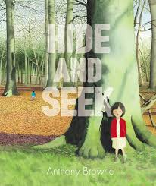
Year 4 - Ash and Birch
Maths
Decimals
Money
Time
Reading
Scotland
Dinosaurs
RE
Sikhism
History
Vikings and Anglo Saxons
Science
States of matter.
Writing
Book Review
Description
Geography
Hawaii
RHE
Dares
Risks
Peer Pressure
What to do in an emergency.
Music
Samba and carnival sounds and instruments.
P.E.
Athletics
Outdoor and adventurous activities.
Class Stories
The Highland Falcon Thief
Spanish
Pets in Spanish

Slide 8



Year 5 - Beech and Sycamore
Maths
Perimeter
Shape
Statistics
Reading
Climate change
Stories from other cultures
RE
Forgiveness and covenants
Computing
Coding
Art
William Morris
Writing
Narrative - Puss in boots
Character description - Holes
History
Victorians
RHE
Marriage
Traditions
Identities
Relationships
NSPCC
Music
South and west Africa
P.E.
Outdoor adventures
Athletics
Class Stories
Climate Rebels - Ben Lerwill
Spanish
Describing Portraits/ People

Slide 9



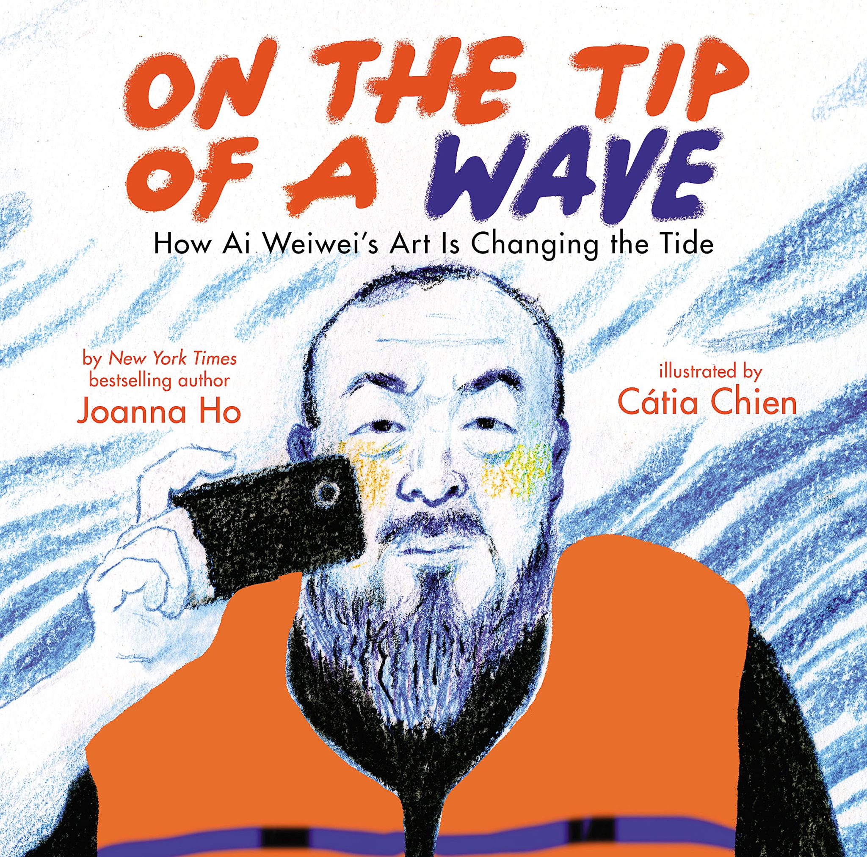
Year 6 - Oak and Sycamore
Maths
Geometry
Arithmetic
Reasoning
Reading
Vocabulary
Inference
Retrieval
Summarise
RE
How do Sikhs symbolise their commitment?
Computing
Coding
Science
Evolution and Inheritance
Writing
Narrative
Explanation
History
Early Islamic Civilisation
RHE
Refugees
Human Rights
NSPCC
MHST
Music
Film Music
Score
Composing
Soundtracks
P.E.
OAA
Athletics
Class Stories
The Doll Twin - Janine Beacham
When the Sky Falls - Phil Earle
Spanish
Describing friends and family

